Slide 1
ATHREYA SIGNATURE TALK
Episode 01
Beyond a Career
Building Meaning Through Work
Presented by Athreya Associates
Notes:
Good morning everyone.
Thank you for taking the time to be here today.
Before we begin, I'd like to ask you something.
Have you ever reached a point in your life where everything seemed to be going well...
Your career was progressing...
Your responsibilities were growing...
Yet somewhere inside, a quiet question kept returning?
(Pause 2 seconds.)
For me, that question was not about changing jobs.
It was not about earning more.
It was much deeper.
It was simply...
"What's next?"
Pause.
Count slowly.
1...
2...
3...
4...
Then continue.
Today's conversation is not about insurance.
It is not about selling a product.
It is not even about changing your profession.
It is about something much more personal.
It is about discovering how our work can become more meaningful.
And if, by the end of today's session, you leave with just one new perspective about your own journey...
I'll consider our time together well spent.
Welcome to Episode 01 – Beyond a Career: Building Meaning Through Work.

Slide 2
Reflection
Every meaningful journey begins with one honest question.
Notes:
A few moments ago, I asked a simple question.
"What's Next?"
Every one of us answers that question differently.
Pause.
1
2
For some...
"What's Next?" means the next promotion.
For others...
it's the next salary increase.
Some think about buying a house.
Some think about their children's education.
Some dream of starting a business.
And some...
are simply trying to create a little more balance in life.
(Pause 2 seconds.)
If you notice carefully...
our answers may be different...
but the question is the same.
Pause.
1
2
Every one of us is moving towards something.
The real question is not...
"What comes next?"
The real question is...
"Why does it matter to me?"
(Pause 3 seconds.)
Today's session is an invitation to explore that question together.
Not to judge our choices...
but to understand them more clearly.

Slide 3

Notes:
You know, for a long time, I never thought I would be having a conversation like this.
I was simply focused on building a successful career.
(Pause 2 sec)
I spent nearly fifteen years in the software industry.
Like many professionals, I believed that if I worked hard, grew in my career, and fulfilled my responsibilities, life would naturally become complete.
And in many ways, things were going well.
Career was progressing.
Responsibilities were increasing.
People around me would probably have described my life as stable.
Pause.
1
2
But something interesting began to happen.
The more I achieved externally, the more I started paying attention to an internal question.
Not a dramatic question.
Not a crisis.
Just a quiet feeling that kept returning.
Pause.
1
2
I realised that I was building a career very successfully…
but I had not paused long enough to ask:
“What kind of life is this career helping me build?”
Pause.
1
2
3
4
That question changed everything.
Not overnight.
Not with a single decision.
But it slowly changed the way I looked at work, success, relationships and responsibility.
And that is why this slide is called “Beyond A Career.”
Because a career is important.
It gives us income.
Identity.
Structure.
Opportunity.
But a career is a part of life.
It is not the whole of life.
Pause.
1
2
Once I understood that difference, I stopped asking only:
“What should I do next?”
I started asking:
“Who do I want to become through the work I do?”
And that question became the turning point of my journey.

Slide 4
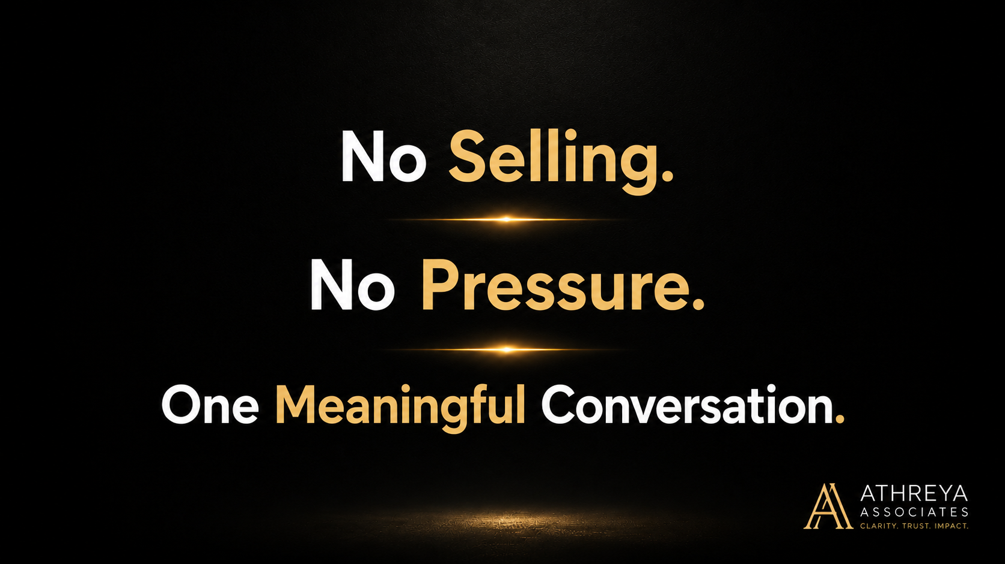
Notes:
As we continue, I want to make something very clear.
This session is not a sales presentation.
You are not here to be convinced of anything.
You are not here to be pressured into a decision.
(Pause 2 sec)
Think of this as one meaningful conversation about work, life, responsibility, and the choices that shape our future.
My goal today is very simple:
If you leave with greater clarity than when you joined, this session has served its purpose.
(Pause 2 sec)
So let’s keep the conversation honest, practical, and human.

Slide 5

Notes:
Let me ask you a question that sounds very simple.
What do you do?
(Pause 2 sec)
Most of us can answer that question in a few seconds.
We say:
“I’m a software engineer.”
“I’m a project manager.”
“I’m a consultant.”
“I run a business.”
“I work in finance.”
And those answers are correct.
But I discovered something interesting.
When someone asks us what we do, we often give our job title.
Very rarely do we describe the impact of our work.
(Pause 2 sec)
Think about it for a moment.
A teacher could say, “I teach mathematics.”
But another teacher might say:
“I help children discover confidence.”
A doctor could say, “I treat patients.”
But another doctor might say:
“I help families regain hope.”
A software professional could say, “I build applications.”
But another might say:
“I solve problems that make people’s lives easier.”
(Pause 2 sec)
Same profession.
Different meaning.
And that was the question that started changing me.
Not just:
“What do I do?”
But:
“What difference does my work create in another person’s life?”
(Pause 4 sec — this is the key pause.)
That question is uncomfortable.
Because it moves us beyond activity.
Beyond busyness.
Beyond titles.
It asks us to think about contribution.
And once you begin thinking in terms of contribution, your relationship with work starts to change.

Slide 6

Notes:
I think this is one of the most important realizations for professionals in our generation.
Being busy is not the same as moving forward.
(Pause 3 sec.)
For many years, my calendar was full.
Meetings.
Deadlines.
Projects.
Escalations.
Travel.
Responsibilities.
And if someone had looked at my schedule, they would probably have said:
“You must be making tremendous progress.”
But one day, I asked myself a difficult question.
Progress toward what?
(Pause 3 sec.)
Because busyness can create an illusion.
We feel productive because we are constantly doing something.
We are answering emails.
Attending calls.
Solving immediate problems.
Managing urgent tasks.
And all of that may be necessary.
(Pause 2 sec.)
But necessary is not always the same as meaningful.
I realized that I had become very good at managing the demands of the present.
What I had not done consistently was design the direction of my future.
(Pause 3 sec.)
That distinction changed me.
You can run fast and still be on the wrong road.
You can be efficient and still be disconnected from what matters most.
And I think many professionals experience this silently.
Not because they lack ambition.
But because the noise of daily responsibilities becomes so loud that the deeper questions become easy to postpone.
(Pause 2 sec.)
So I started asking myself a new question.
Not:
“How can I become busier?”
But:
“How can my work move me toward a life that feels meaningful, aligned, and worth building?”
(Pause 4 sec — this is the key pause of the slide.)
That question became a compass.
And once you have a compass, activity is no longer enough.
Direction begins to matter.

Slide 7

Notes:
After asking myself whether I was truly moving forward, another question emerged.
And honestly, this question felt even more personal.
Who am I becoming through the life I am living every day?
(Pause 4 sec — let this question breathe.)
Think about that for a moment.
Not what you are achieving.
Not what others think of you.
Not what is written in your LinkedIn profile.
Who are you becoming?
(Pause 3 sec.)
Because work does something very subtle.
It does not only produce outcomes.
It also shapes habits.
It shapes priorities.
It shapes relationships.
It shapes the way we respond to stress, success, failure, and responsibility.
(Pause 2 sec.)
A person can become highly efficient but emotionally exhausted.
A person can become professionally successful but personally disconnected.
A person can become financially stable but internally uncertain about what truly matters.
And I realized that these changes happen gradually.
Not in one dramatic moment.
They happen through thousands of ordinary days.
(Pause 2 sec.)
The meetings we attend.
The conversations we avoid.
The time we give to our family.
The attention we give to our health.
The values we compromise.
The values we protect.
Little by little, these choices answer the question:
Who am I becoming?
(Pause 4 sec — this is the key pause of the slide.)
That realization was both uncomfortable and liberating.
Uncomfortable, because it forced me to look honestly at my own life.
Liberating, because it reminded me that identity is not fixed.
We are constantly becoming.
And if we are constantly becoming, then we have the opportunity to become more intentional about the person our work is shaping us into.
That insight became one of the most important foundations of my journey.

Slide 8

Notes:
After all the questions we’ve explored so far, I want to simplify something.
We often assume that meaningful change begins with a perfect plan.
A five-year strategy.
A complete roadmap.
Absolute certainty.
But my experience has been very different.
Every meaningful journey begins with one question.
(Pause 3 sec — let the slide and the sentence stay together.)
Think about the journeys that changed your own life.
A relationship.
A career decision.
A business.
A move to a new city.
A health transformation.
Very rarely did those journeys begin with complete clarity.
They usually began with a question.
(Pause 2 sec.)
For me, that question was:
“What kind of life is this career helping me build?”
That single question did not give me all the answers immediately.
But it changed the direction of my attention.
And sometimes, that is how transformation begins.
Not with a giant leap.
But with a small, honest question that refuses to disappear.
(Pause 2 sec.)
Once I stopped ignoring that question, my journey started unfolding in ways I had never planned.
And I’d like to share that journey with you—not because it is extraordinary, but because it may help you recognize the questions that are quietly shaping your own life.

Slide 9
The Journey
Fifteen years of software. One decision changed everything.
Notes:
So let me take you back for a moment.
Back to a phase of my life when everything looked stable from the outside.
I had a career. Responsibilities. A routine. Goals that I was working toward.
And if someone had asked me at that time, “How is life going?”, I would probably have answered:
“It’s going well.”
(Pause 2 sec.)
But journeys rarely announce themselves when they begin.
Most of the time, they start quietly.
A question appears.
A feeling returns repeatedly.
Something inside us says:
“There may be more to understand here.”
(Pause 2 sec.)
That is exactly what happened to me.
I did not wake up one day with a completely new philosophy.
I did not suddenly decide to change my life.
What happened was much simpler—and much more human.
I began paying attention to a question that would not leave me alone.
(Pause 2 sec.)
And that question slowly started changing the way I looked at work, success, responsibility, and meaning.
Looking back now, I realize that the journey was not a straight line.
It was a series of moments, reflections, conversations, and realizations that gradually connected together.
And I’d like to share the next part of that journey with you, because it begins with something very ordinary…
my story.

Slide 10

Notes:
So who was the person asking all these questions?
This is my story.
(Pause 2 sec.)
I come from a background that values responsibility, education, hard work, and doing the right thing even when nobody is watching.
Like many people in India, I grew up believing that if I studied well, built a stable career, took care of my family, and fulfilled my responsibilities, I would be living a successful life.
And honestly, that belief gave me discipline.
It gave me direction.
It helped me build a career.
(Pause 2 sec.)
I was not someone chasing fame or extraordinary recognition.
I was a professional trying to do good work, support my family, grow steadily, and create stability.
From the outside, my life looked quite normal.
A career.
A routine.
Responsibilities.
Goals.
The kind of life millions of professionals are building every day.
(Pause 2 sec.)
And that is exactly why this story matters.
Because the questions that changed me did not arise from failure.
They arose in the middle of a reasonably successful life.
(Pause 3 sec.)
That realization was important.
It taught me that meaning is not a problem that appears only when life collapses.
Sometimes it appears when life is functioning well, yet something inside us asks:
“Is this the complete picture of what my life is meant to become?”
(Pause 4 sec — this is the emotional peak of the slide.)
That question did not make me reject my past.
It made me look at my life with greater honesty.
And that honesty became the beginning of a much deeper journey.

Slide 11
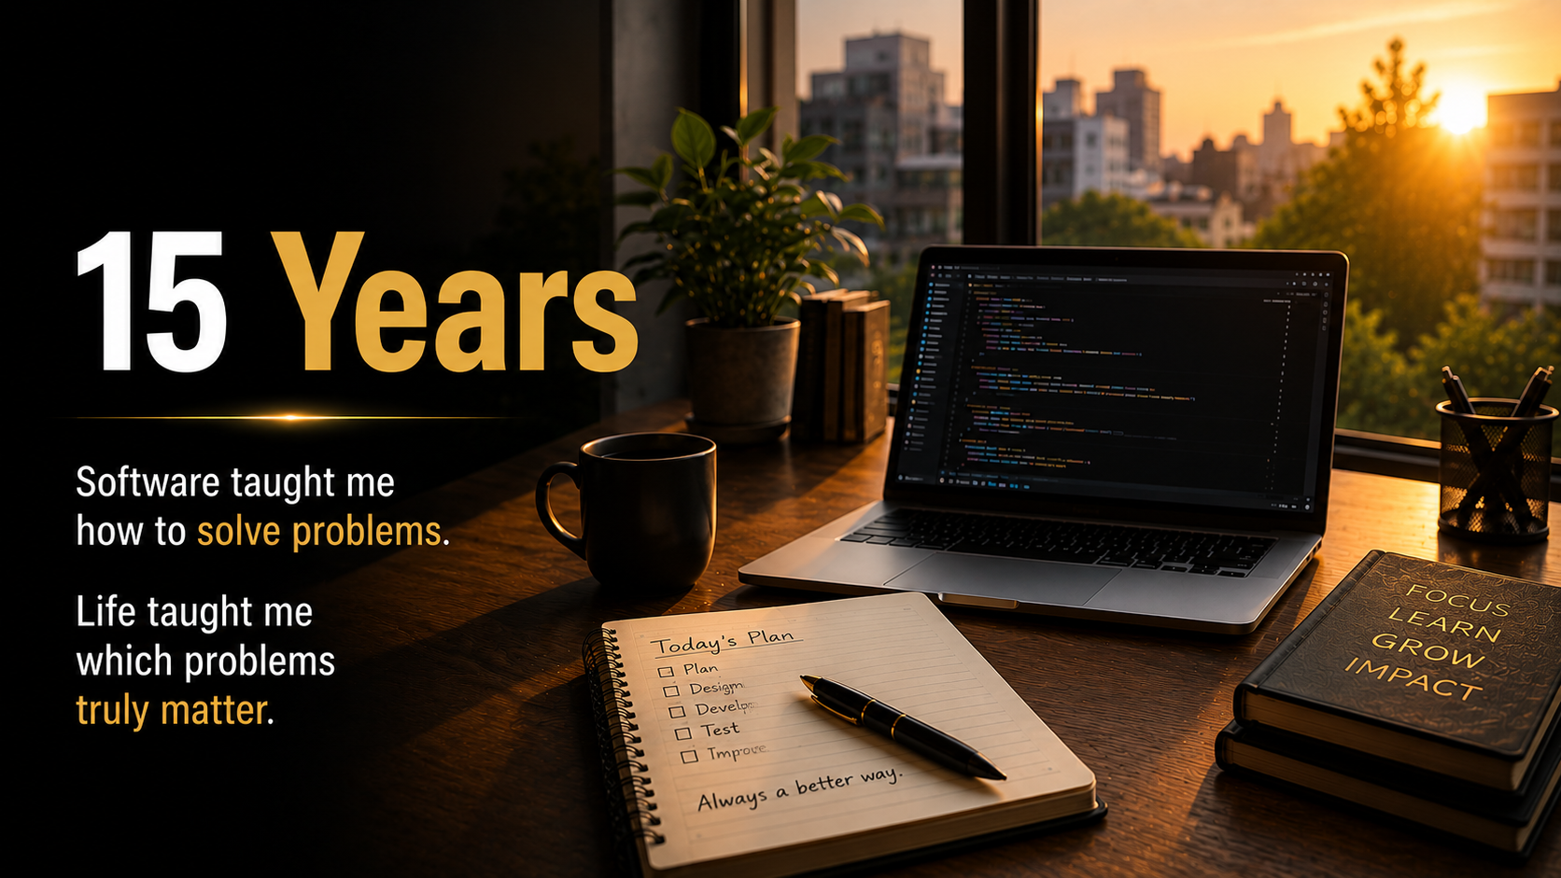
Notes:
That chapter lasted nearly fifteen years.
Fifteen years of software industry life.
Fifteen years of learning, building, solving problems, working with teams, handling deadlines, and growing through different phases of a professional career.
(Pause 2 sec.)
When I look back at those years, I don’t remember only projects.
I remember the rhythm of the life that came with them.
The early mornings.
The production issues.
The urgent calls.
The pressure to deliver.
The satisfaction of solving difficult problems.
The responsibility of being dependable.
The constant feeling that there was always another milestone ahead.
(Pause 2 sec.)
And in many ways, those years were valuable.
They taught me discipline.
They taught me resilience.
They taught me how to work with people, how to adapt, and how to keep moving even when circumstances changed.
I am genuinely grateful for that chapter of my life.
(Pause 2 sec.)
But something else was happening at the same time.
The longer I stayed on the path of achievement, the more I began to notice a quiet gap between external progress and internal clarity.
From the outside, the journey made sense.
From the inside, a question was becoming louder.
(Pause 3 sec.)
And that is what made those fifteen years so important.
Not because they were perfect.
Not because they were unsuccessful.
But because they gave me enough experience to recognize a question that I could no longer ignore.
A question that eventually became the turning point of my entire journey.

Slide 12

Notes:
After nearly fifteen years of career growth, responsibility, achievement, and constant movement, everything seemed to come down to one question.
Not a complicated question.
Not a philosophical theory.
Not something I learned from a book.
Just one honest question that kept returning, no matter how busy life became.
(Pause 3 sec.)
And that question was:
“What kind of life is this career helping me build?”
(Pause 6 sec — this is the most important silence in the entire keynote.)
I want you to notice something.
The question is not:
“Is my career successful?”
The question is:
“What is my career helping me create?”
Because a career is a powerful force.
It shapes our time.
Our energy.
Our relationships.
Our health.
Our attention.
Our future.
And if something influences so much of our life, then it is reasonable to ask:
What kind of life is it helping me build?
(Pause 3 sec.)
When I first asked that question, I did not have an answer.
And that was uncomfortable.
I had spent years becoming skilled at solving professional problems, yet I realized I had not paused long enough to examine the larger direction of my life.
(Pause 2 sec.)
That question became a mirror.
It forced me to look beyond salary, designation, milestones, and external validation.
And once I stopped avoiding the question, my entire perspective began to change.
Not overnight.
Not dramatically.
But permanently.
(Pause 3 sec.)
Looking back now, I can say this with complete honesty:
That one question changed the direction of my life more than any promotion, project, or professional milestone ever did.
(Pause 4 sec.)
And I believe many meaningful transformations begin exactly this way.
Not with a perfect answer.
But with a question we finally become willing to face honestly.

Slide 13
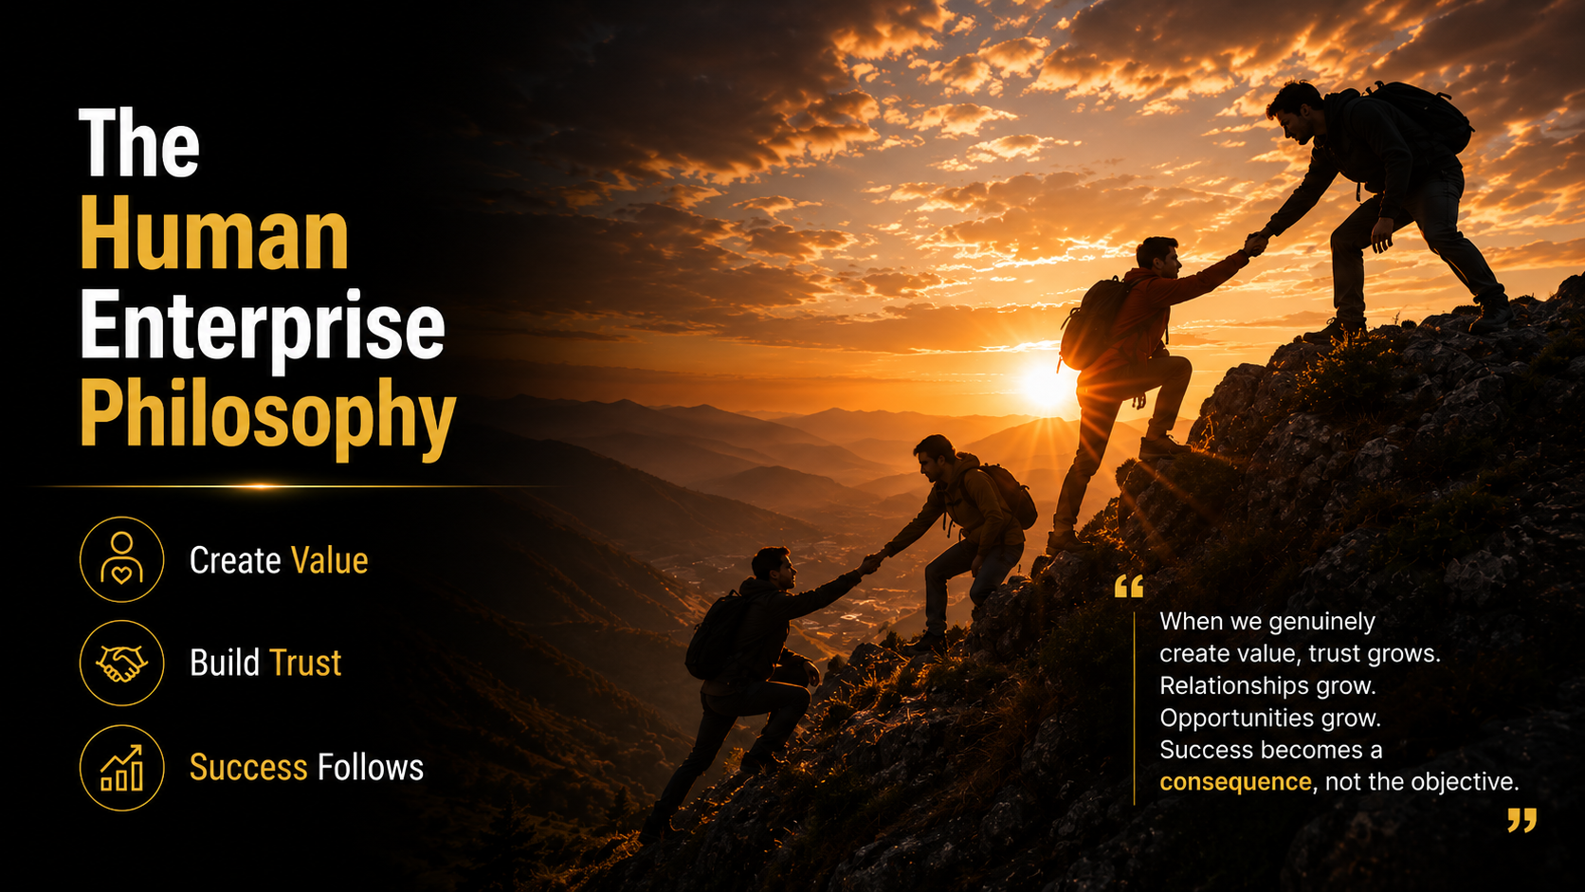
Notes:
The question changed my perspective, but it also created a new search.
I began asking:
If a career is only a part of life, then what is the right relationship between work, success, responsibility, and human meaning?
That search eventually became the foundation of what I now call The Human Enterprise Philosophy.
(Pause 3 sec.)
At its core, the philosophy is very simple.
An enterprise is not only an economic activity. It is a human activity.
(Pause 3 sec.)
We often measure work through numbers:
revenue,
targets,
promotions,
performance,
growth.
Those things matter.
But they do not tell the complete story.
The complete story includes the human being behind the work.
(Pause 2 sec.)
So the Human Enterprise Philosophy is built on one central idea:
Work should help us create value for others while helping us become better human beings ourselves.
(Pause 5 sec — this is the key line of the slide.)
Notice the two parts.
Create value for others. That is contribution.
Become better human beings ourselves. That is character.
Contribution without character can become empty ambition.
Character without contribution can remain unrealized potential.
Meaningful work requires both.
(Pause 2 sec.)
This philosophy does not reject success.
It gives success a deeper purpose.
It asks us to see our profession not merely as a source of income, but as a platform for:
service,
responsibility,
growth,
integrity,
and human impact.
(Pause 2 sec.)
When I began viewing my work through this lens, many decisions became clearer.
The question was no longer only:
“What will help me advance?”
It became:
“What creates value, aligns with my principles, and helps me become the person I want to be?”
That is the essence of the Human Enterprise Philosophy.

Slide 14
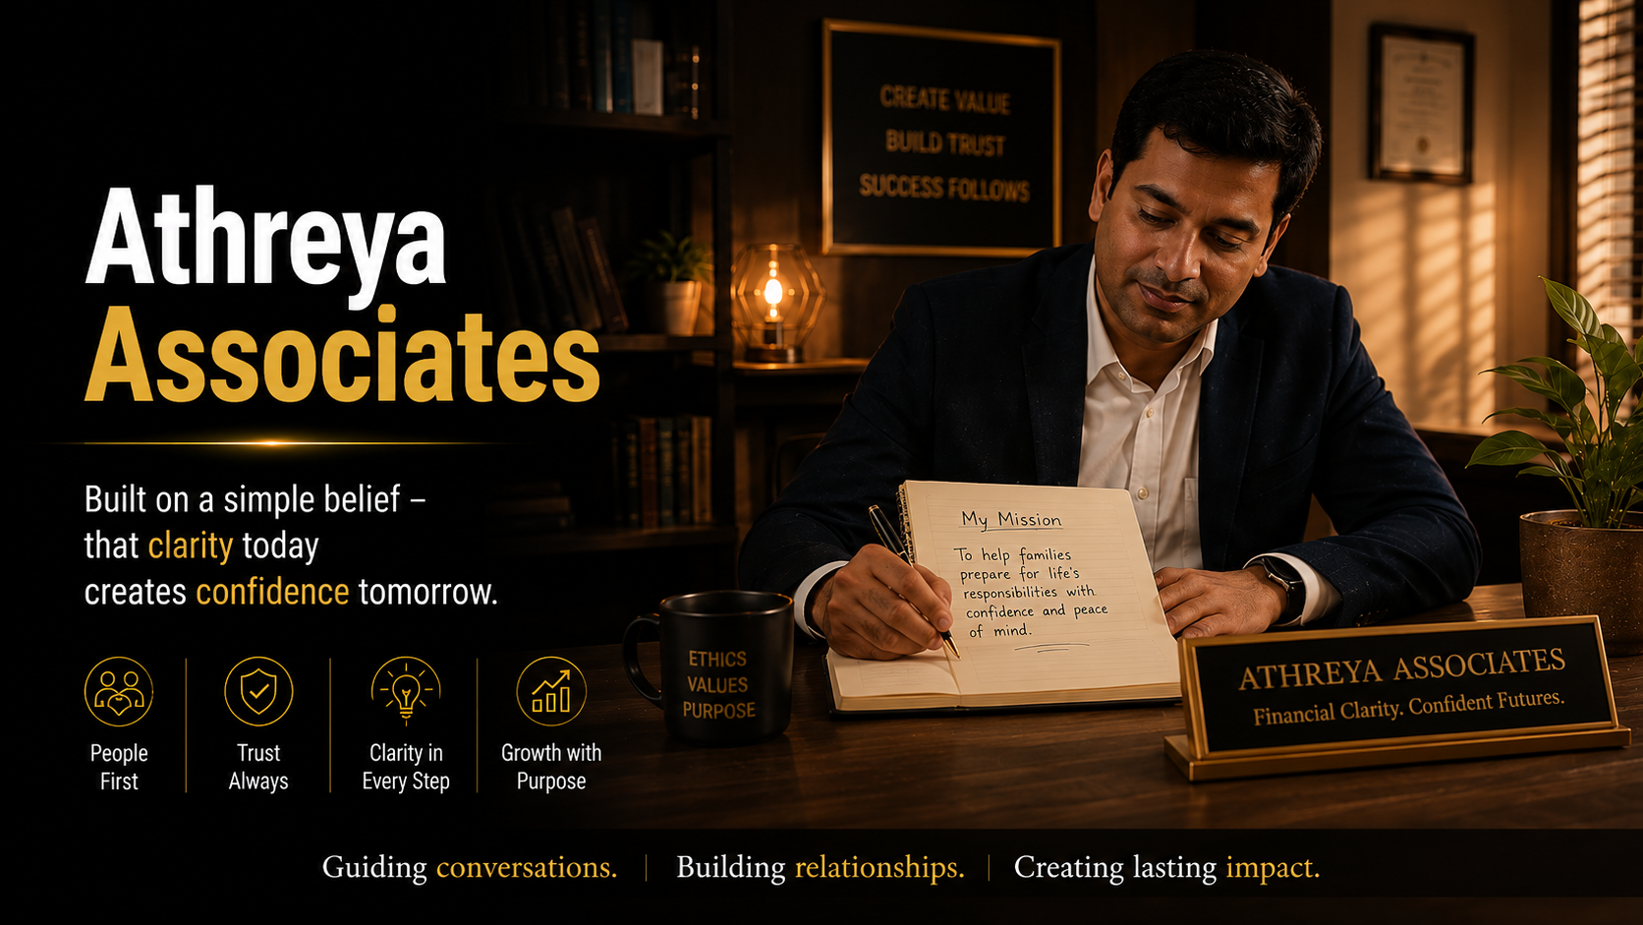
Notes:
Once the Human Enterprise Philosophy became clear to me, I realized something important.
A philosophy has value only when it is lived in the real world.
It cannot remain just a good idea.
It needs a practical expression.
And for me, that practical expression became Athreya Associates.
(Pause 3 sec.)
People often ask, “What exactly is Athreya Associates?”
The simplest answer is this:
It is a practice built around helping people make clearer, more responsible decisions about the life they are trying to build.
(Pause 3 sec.)
Over the years, I realized that many families are not suffering from a lack of information.
They are suffering from confusion, overwhelm, delayed decisions, and the absence of trusted guidance.
Especially during moments that matter most:
protecting a family,
planning for uncertainty,
preparing for responsibilities,
and making financial decisions that affect the people they love.
(Pause 2 sec.)
So Athreya Associates was shaped around a different question.
Not:
“What product can we sell?”
But:
“What decision can we help a family make with greater clarity and confidence?”
(Pause 4 sec — this is the key line of the slide.)
That is why I describe my role as a Financial Clarity Partner.
Because clarity changes behavior.
When people gain clarity, they stop postponing important decisions.
They stop acting out of fear or pressure.
They begin making choices that align with their responsibilities, values, and long-term vision.
(Pause 2 sec.)
So Athreya Associates is not separate from the Human Enterprise Philosophy.
It is the place where that philosophy is practiced through real conversations, real families, and real life decisions.
And that is the bridge between a personal realization and a meaningful enterprise.

Slide 15
The Invitation
Let's continue the conversation.
Notes:
So after everything I’ve shared today—the questions, the journey, the fifteen years, the philosophy, and the practical expression through Athreya Associates—I want to leave you with an invitation.
Not an obligation.
An invitation.
(Pause 2 sec.)
An invitation to pause and ask yourself one honest question:
“What kind of life am I consciously building through the work I do every day?”
(Pause 4 sec — let this land.)
You do not need to answer it tonight.
You do not need to make a major decision immediately.
But I encourage you not to ignore it.
Because the questions we postpone often become the directions we postpone.
(Pause 2 sec.)
If this conversation has resonated with you, my invitation is simple:
Continue the conversation.
Reflect on the question.
Talk about it with your family.
Examine the relationship between your career, your values, your responsibilities, and the future you want to create.
(Pause 2 sec.)
And if you ever feel that you would benefit from a deeper conversation about clarity, direction, protection, responsibility, or the life you are trying to build, I would be happy to walk through that conversation with you.
Not to tell you what to do.
But to help you see your choices more clearly.
(Pause 3 sec.)
Because that is the essence of the Human Enterprise Philosophy:
People do not always need more pressure. They often need more clarity.
(Pause 4 sec — this is the key line of the slide.)
And clarity, when it is combined with responsibility and honest action, has the power to change the direction of a life.
That is my invitation.

Slide 16

Notes:
So why does all of this matter?
Why spend time talking about identity, direction, contribution, and the kind of life our work is helping us build?
Because these questions do not remain theoretical for very long.
They eventually show up in the lives of the people we love.
(Pause 2 sec.)
The career decisions we make affect our family’s time, stability, energy, and future.
The financial decisions we postpone can become burdens that someone else has to carry later.
The clarity we gain today can prevent confusion during the moments when life becomes difficult.
(Pause 2 sec.)
And I learned this very personally.
When a family faces a health challenge, a financial shock, an unexpected responsibility, or a moment of uncertainty, they rarely say:
“I wish we had attended one more meeting.”
What they often wish is:
“I wish we had prepared earlier.”
(Pause 4 sec — this is the key emotional line of the slide.)
That is why clarity matters.
Clarity helps us act before urgency forces us to react.
Clarity allows us to make decisions when we are calm, thoughtful, and aligned with our values.
And those decisions can create extraordinary peace for a family.
(Pause 2 sec.)
So this conversation is not ultimately about careers.
It is about responsibility.
It is about protecting what matters before life tests it.
It is about creating a future in which the people we love are not left vulnerable because important decisions were delayed.
(Pause 3 sec.)
That is why this matters.
Not because we can control everything.
We cannot.
But because we can choose to live with greater awareness, preparation, and intention.
And that choice has the power to change not only our own life, but the experience of the people who depend on us.

Slide 17

Notes:
When I look back at my journey now—from the software industry, through the questions, the philosophy, and the work I do today—I realize something very clearly.
My deepest search was never simply about changing a profession.
It was about discovering a way of living that felt more than a career.
(Pause 3 sec.)
A career can give us income.
It can give us achievement.
It can give us recognition, growth, and opportunities.
And all of those things are valuable.
But a human life is larger than a job description.
(Pause 2 sec.)
At the end of our lives, people are unlikely to remember us only for:
the projects we completed,
the targets we achieved,
the meetings we attended,
or the designations we held.
What often remains is something much more human.
The relationships we nurtured.
The integrity with which we lived.
The peace we created for our family.
The people we helped.
The values we protected when it was difficult.
The kind of person we became through the journey.
(Pause 3 sec.)
That is what I mean by “More Than a Career.”
It is not a rejection of ambition.
It is an expansion of ambition.
(Pause 2 sec.)
Instead of asking only:
“How high can I climb?”
We begin asking:
“What kind of life am I creating while I climb?”
(Pause 4 sec — this is the key line of the slide.)
That question changes priorities.
It changes decisions.
It changes the way we define success.
Success is no longer only external achievement.
It becomes the alignment between:
what we do,
what we value,
and the life we are consciously building.
(Pause 2 sec.)
And that, for me, is the real meaning of a meaningful enterprise.
Not merely earning a living.
But building a life that allows us to contribute, grow, protect what matters, and become more fully human in the process.

Slide 18
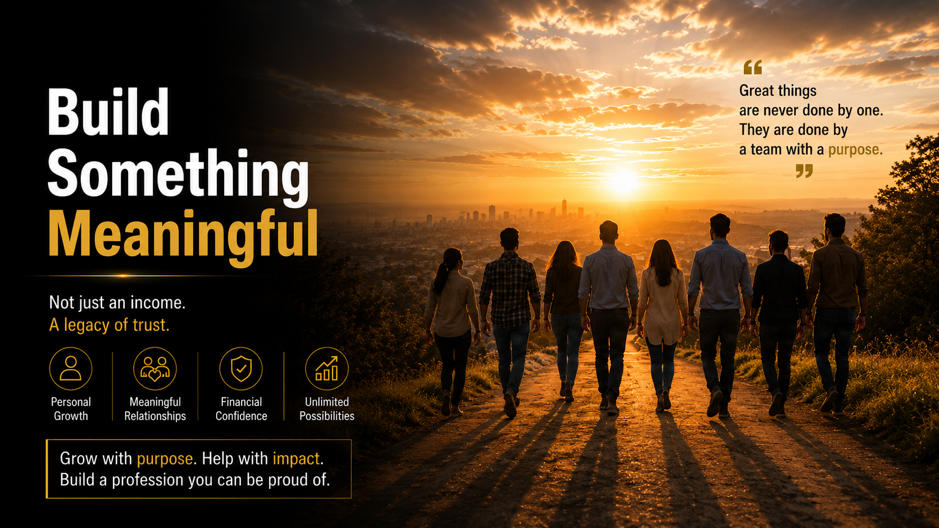
Notes:
After all the reflection we’ve done today, I want to leave you with a hopeful idea.
We still have the ability to build something meaningful from where we are right now.
(Pause 3 sec.)
Meaningful does not necessarily mean massive.
It does not require fame, extraordinary success, or a perfect life.
A meaningful life is often built through consistent, intentional choices.
(Pause 2 sec.)
A meaningful conversation with a family member.
A meaningful decision made before a crisis.
A meaningful act of responsibility.
A meaningful commitment to health, integrity, learning, or contribution.
Little by little, these choices become the architecture of a meaningful life.
(Pause 2 sec.)
And the same is true for our work.
We may not be able to control every market condition, every organizational change, or every uncertainty that life brings.
But we can choose the spirit with which we work.
We can choose whether our work creates confusion or clarity, fear or confidence, pressure or peace, transaction or genuine human value.
(Pause 3 sec.)
That is why I no longer think of success as something we merely achieve.
I think of success as something we build.
We build it through the decisions we repeat.
We build it through the values we refuse to abandon.
We build it through the people we help along the way.
And we build it through the courage to align our work with the kind of human being we want to become.
(Pause 3 sec.)
So my message today is not:
“Quit your career.”
It is not:
“Start a business.”
It is not:
“Follow someone else’s path.”
My message is much simpler.
Build something meaningful.
(Pause 4 sec — this is the key line of the slide.)
Build a career that supports the life you want to live.
Build relationships that outlast achievements.
Build habits that create long-term peace.
Build clarity before urgency arrives.
Build a future in which the people you love are protected, supported, and able to thrive.
And if you do that consistently, you may discover that success becomes not just something visible from the outside, but something deeply felt from the inside.

Slide 19
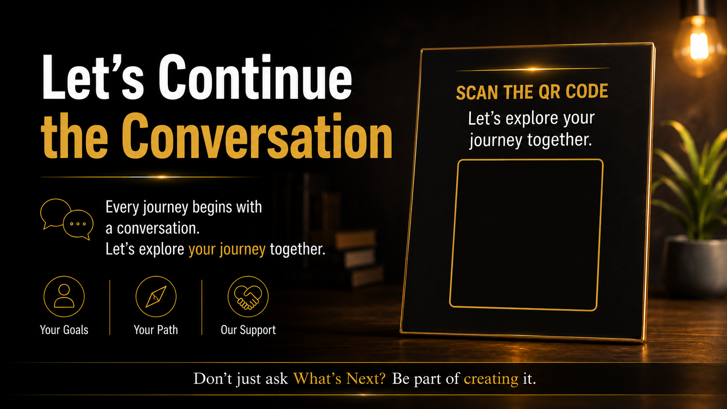
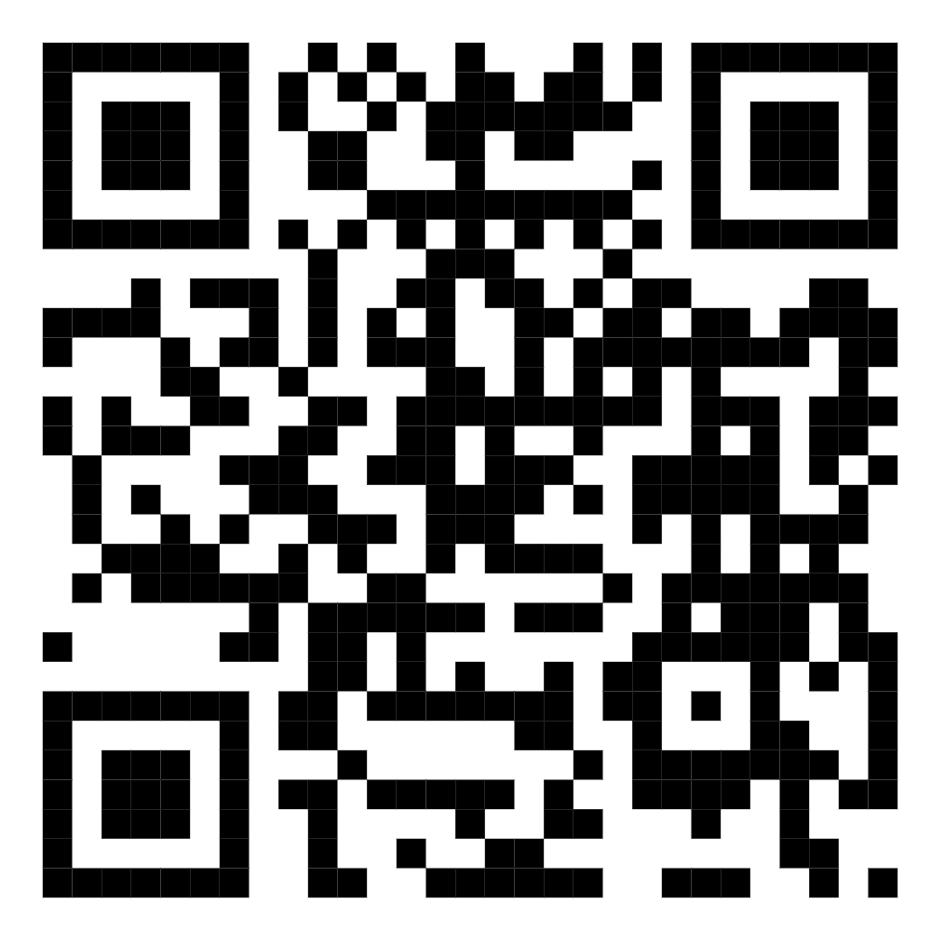
Notes:
As we come close to the end of this session, I want to thank you for something that is easy to overlook.
Thank you for giving your attention.
In a world filled with constant notifications, deadlines, meetings, and distractions, attention has become one of the most valuable gifts we can offer another human being.
(Pause 2 sec.)
Today was never about convincing you of a particular product, career path, or life decision.
It was about creating a space where we could ask deeper questions together.
Questions about:
the life we are building,
the person we are becoming,
the responsibilities we carry,
and the future we want to create for the people we love.
(Pause 2 sec.)
If even one question from today stays with you after this webinar ends, I believe our time together has been meaningful.
Maybe it is:
“What kind of life is my career helping me build?”
Maybe it is:
“Who am I becoming through my daily choices?”
Or maybe it is simply:
“What decision have I been postponing because I lacked clarity?”
(Pause 3 sec.)
My invitation is not to make a rushed decision.
My invitation is to continue the conversation.
Reflect on the questions.
Discuss them with your family.
Observe your own life with greater honesty.
And if, at any point, you feel that a deeper conversation about clarity, direction, protection, responsibility, or the future you are trying to build would be valuable, I would genuinely be happy to have that conversation with you.
(Pause 3 sec.)
Not as a transaction.
But as a human conversation about what matters most.
Because I have come to believe that meaningful change rarely happens through pressure.
It happens through clarity, trust, reflection, and honest dialogue.
(Pause 4 sec — this is the key line of the slide.)
So let’s not end this as a webinar.
Let’s continue it as a conversation.

Slide 20
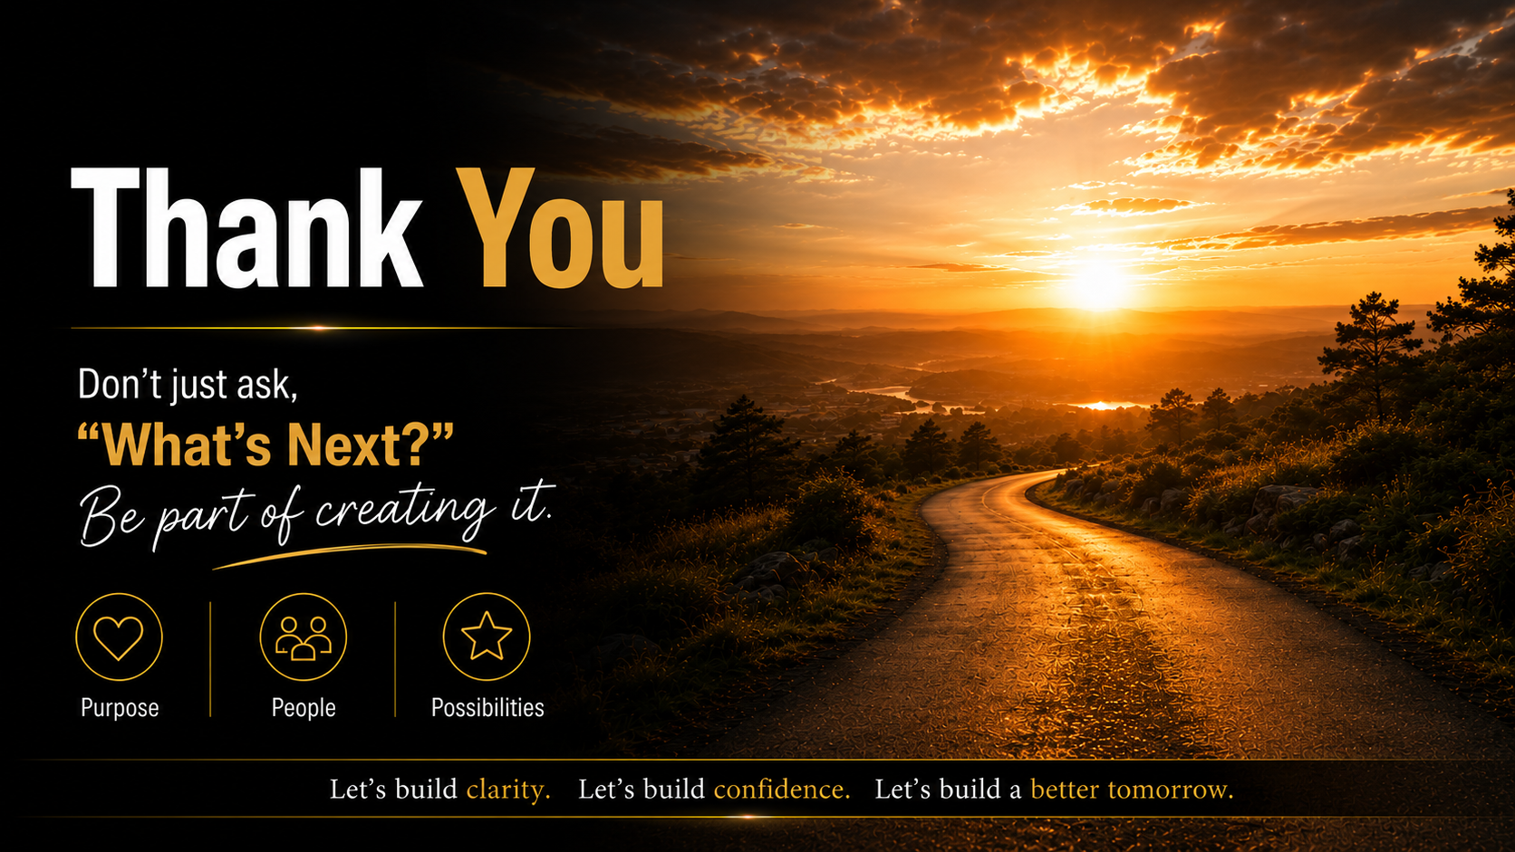
Notes:
Thank you.
Thank you for your time, your attention, your openness, and your willingness to reflect on questions that are often easy to postpone.
(Pause 2 sec.)
When we began today, we started with a simple question:
What’s next?
And as the conversation unfolded, we discovered that the answer is rarely just a new job, a promotion, a business, or a financial milestone.
Sometimes the deeper answer is a more meaningful life.
(Pause 2 sec.)
A life built with greater clarity.
Greater responsibility.
Greater alignment between what we do, what we value, and the future we are consciously creating.
(Pause 2 sec.)
I don’t want to end by giving you a final answer.
I want to leave you with a question worth carrying forward.
What is the next meaningful step in the life you are consciously building?
(Pause 6 sec — this is the final silence of the keynote.)
You do not need to answer it immediately.
But if you continue asking it honestly, it may guide decisions that shape your career, your family, your contribution, and the person you become over the years ahead.
(Pause 2 sec.)
Thank you for being part of this conversation.
And remember:
Don’t just ask “What’s Next?”
Be part of creating it.
(Pause 3 sec. Smile gently. Hold eye contact.)
Thank you, and I wish you clarity, peace, and a deeply meaningful journey ahead.

